Slide 1


PANIMALAR ENGINEERING COLLEGE
Department of Computer Science and Engineering
Project Review
SOUND CLASSIFICATION FOR RESPIRATORY DISEASES USING MACHINE LEARNING TECHNIQUE
Project Guide:
Mr. N.SATHISH M.E.,
ASSISTANT PROFESSOR.
DEPARTMENT OF CSE,
PANIMALAR ENGINEERING COLLEGE.
Team Members:
DAKSHNA MOORTHY P (211417104046)
HARIKRISHNA M (211417104076)
JUDE MATHEW (211417104102)
Batch Number: E4

Slide 2
INTRODUCTION
The classification and identification of breathing diseases is a tedious task. The sound that is produced when a person breathes is directly associated with the movement of air, variations in the lung tissue and the position of the secretions inside the lung.
A wheezing sound is an example for a person with obstructive disease like asthma or chronic obstructive pulmonary disease (COPD).
An acoustic device used to detect the breath sounds of a patient is the stethoscope, a diaphragm in stethoscope can detect normal breath sounds and abnormal breath sounds without increasing lower frequency masking sounds.
Identification of normal and abnormal respiratory sounds such as crackles, wheezes is very essential for accurate diagnosis of the diseases.
Diagnosis of the diseases from lung sounds needs professional training and experts. This is undoubtedly costly and inconvenient. In this context a technique that can automatically and accurately classify the sounds of lungs into many groups is very meaningful.

Slide 3
LITERATURE SURVEY
YEAR OF PUBLISH | AUTHOR | NAME OF THE PAPER/JOURNAL | DESCRIPTION
2001 | Hiroshi kiyokawa, Matthew Greenberg, Kazuiko Shirota,Hans Pasterkamp | Auditory detection of simulated crackles in breath sounds | To establish the audibility of simulated crackles introduced in breath sounds of different intensity, to study the effects of crackle characteristics on their audibility, and to investigate crackle detection within and between observers.
2012 | Andrs, Emmanuel | Advances and Perspectives in the Field of Auscultation, with a Special Focus on the Contribution of New Intelligent Communicating Stethoscope | Aims to review recent technological advances, evaluate promising innovations and perspectives in the field of auscultation, with a special focus on the development of new intelligent communicating stethoscope systems in clinical practice, and in the context of teaching and telemedicine.
2017 | Renars Xaviero Adhi Pramono, Stuart bowyer, Esther Rodriguez-Villegas | Automatic Adventitious Respiratory Sound Analysis: A Systematic Review | Background Automatic detection or classification of adventitious sounds is useful to assist physicians in diagnosing or monitoring diseases such as asthma, Chronic Obstructive Pulmonary Disease (COPD), and pneumonia.
2018 | B. M. Rocha, D. Filos, L. Mendes, I. Vogiatzis and 10 others | Respiratory Sound Database for the Development of Automated Classification | The database was created by two research teams in Portugal and in Greece, and it includes 920 recordings acquired from 126 subjects. The cycles were annotated by respiratory experts as including crackles, wheezes, a combination of them, or no adventitious respiratory sounds.

Slide 4
PROBLEM STATEMENT
Respiratory sounds are one of the important signs of lung health and respiratory disorders. These respiratory sounds can acquire using digital stethoscopes and other recording devices. This advanced information opens up the chance of utilizing artificial intelligence (AI) to naturally analyse respiratory scatters like asthma, pneumonia and bronchiolitis, to give some examples. A very high number of people lose their lives to different respiratory diseases every day. Respiratory Sound Analysis has been a key tool to accurately detect these types of diseases. Earlier manual detection of respiratory sounds was used but it is not feasible to detect various lung diseases due to various reasons like audio quality and perceptions of different doctors. Modern computer aided analysis helps to give much better results in identifying the diseases from the sound i.e. identification of wheezes and crackles and thus better treatment can be given to patients. These respiratory sound diseases include Asthma, Bronchitis, Pneumonia, COPD and URTI. The prediction with decision trees gives an accuracy rate of 90 percent. This research will be very helpful for the healthcare professionals such as doctors for the easy and accurate diagnosis of respiratory diseases. This study will be a major contribution in the area of the respiratory disease classification by using lungs sounds. In this project a web application is created with ease of access for the user.

Slide 5
TECHNOLOGY STACK
HARDWARE REQUIREMENTS SOFTWARE REQUIREMENTS
HARD DISK | >90GB
PROCESSOR | >Core i3 2.4GHz
SYSTEM TYPE | 32bit / 64 bit
RAM | >2GB
OPERATING SYSTEM | WINDOWS 7/8/8.1/10
INTEGRATED DEVELOPMENT KIT | ANACONDA V2019, JUPYTER NOTEBOOK
PROGRAMMING LANGUAGE (BACKEND) | PYTHON V 3.6
PROGRAMMING LANGUAGE (FRONTEND) | HTML, CSS
DATABASE | PYTHON SQLITE 3
APPLICATION PROGRAMMING INTERFACE (API) | SCIKIT LEARN, FLASK, WERKZEUG

Slide 6
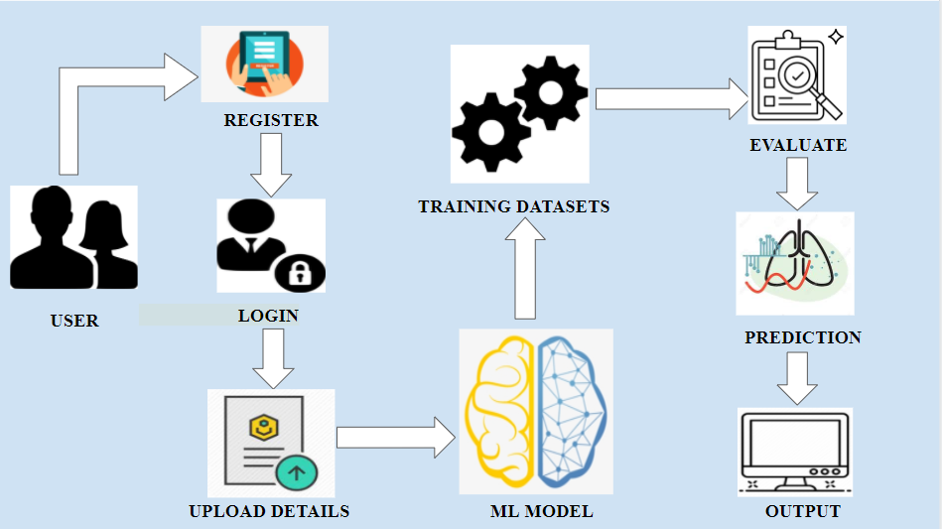
SYSTEM ARCHITECTURE

Slide 7
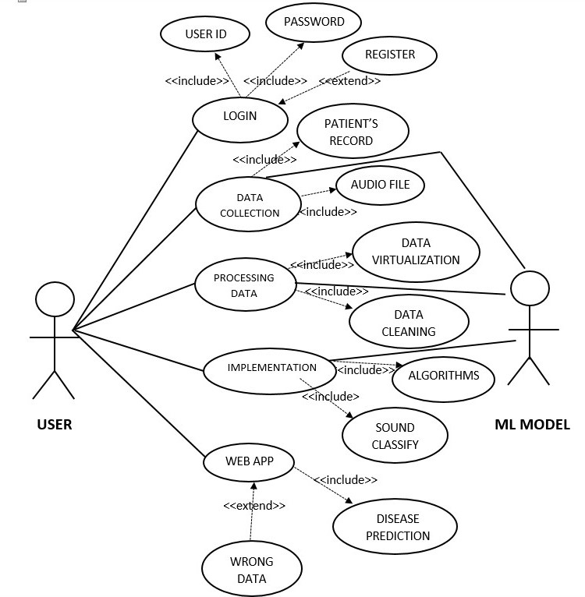
USE CASE DIAGRAM

Slide 8
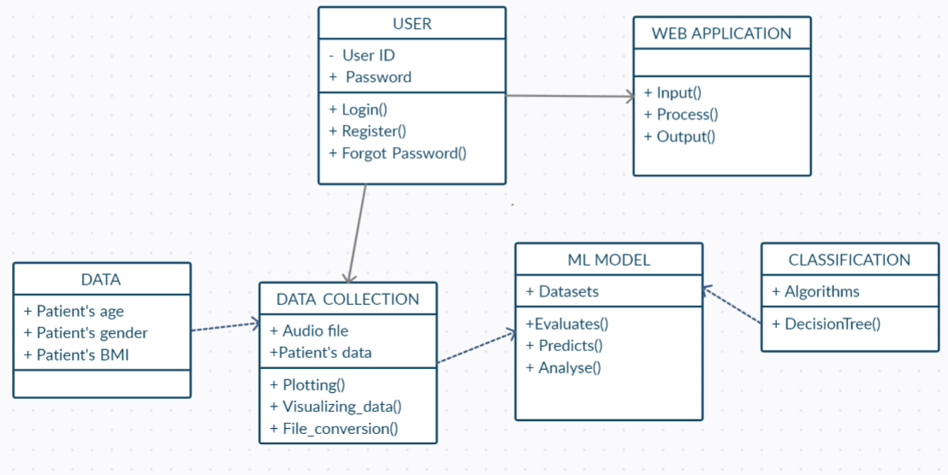
CLASS DIAGRAM

Slide 9
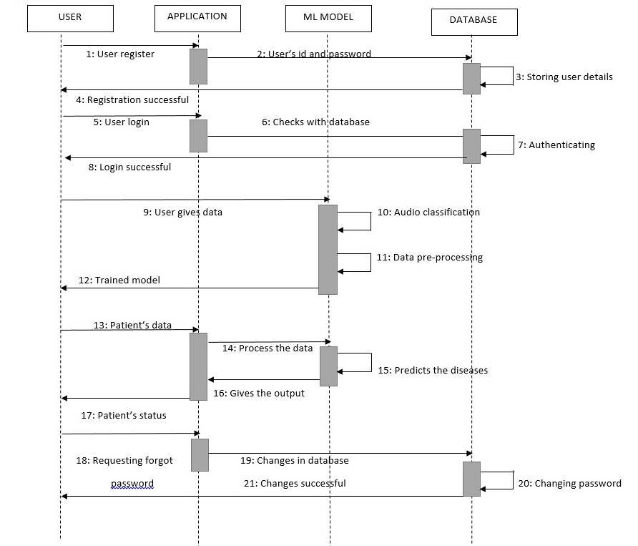
SEQUENCE DIAGRAM

Slide 10
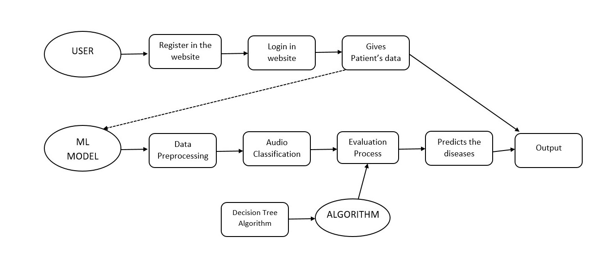
SYSTEM FLOW DIAGRAM

Slide 11
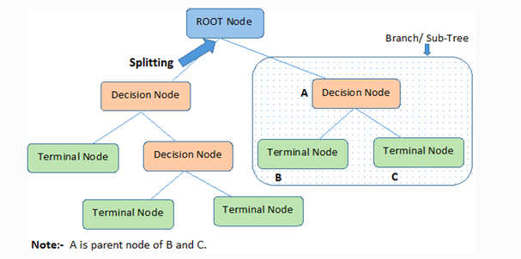
ALGORITHM
Decision Tree algorithm forms part of the supervised learning algorithms family. The decision tree algorithm can also be used to solve regression and classification problems, unlike other supervised learning algorithms.

Slide 12
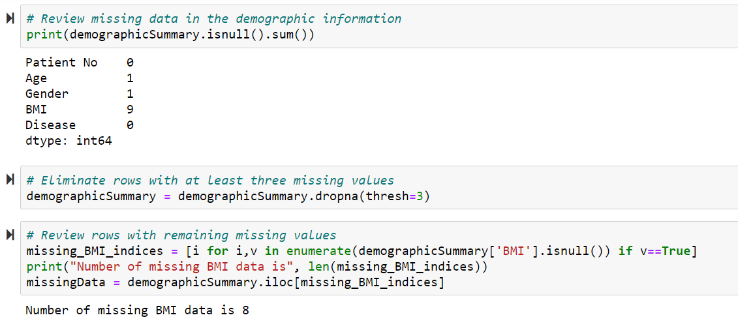
Handling Missing Data
In this section a preprocessing method for handling the missing data is done. The data files are read which gives the demographic information, patient details and combine them to create a new preprocessed data.

Slide 13
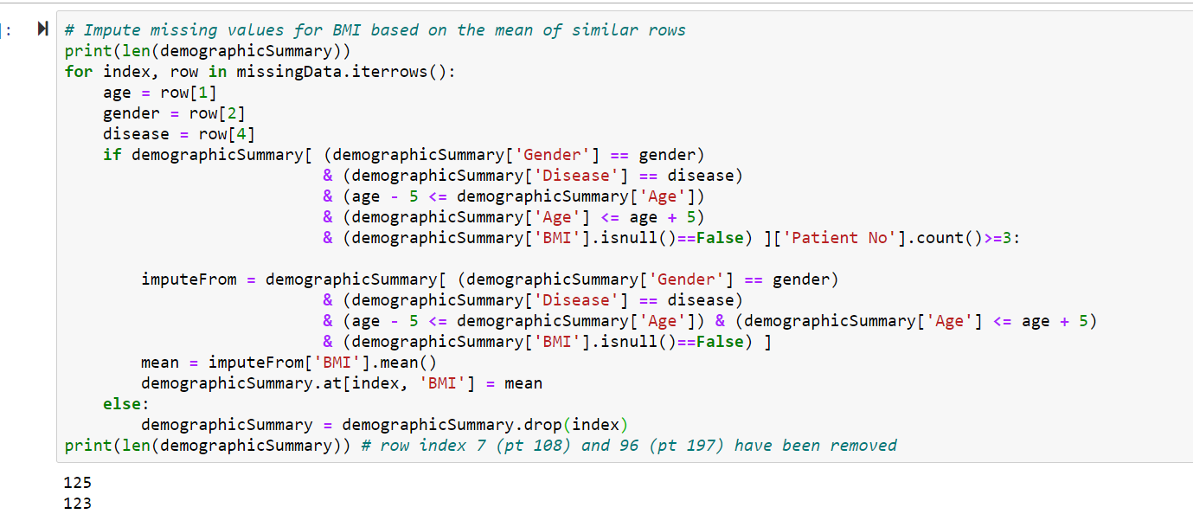

Slide 14
Data collection and audio segmentation
In this module the data is collected in the form of audio, these audio files are stored and they are converted in the form of a text file, this is how the data is collected.
The respiratory sounds were recorded utilizing a multi-channel or single channel obtaining technique, with each channel highlighting to an auscultating purpose of the member and each channel is saved in different files.
The auscultation points are: Anterior right (Ar), Lateral Right (Lr), Posterior right (Pr), Trachea (Tc), Anterior left (Al), Lateral left (Ll) and Posterior left (Pl).

Slide 15
Preprocessing and cleaning
Data preprocessing involves the transformation of the raw dataset into an understandable format.
Preprocessing data is a fundamental stage in data mining to improve data efficiency.
The data preprocessing methods directly affect the outcomes of any analytic algorithm.
These datas are pre-processed and we have to clean the unwanted values all the null values.

Slide 16
Respiratory disease classification
The collected datasets, processing of data, training the model all these are executed to predict the type of disease the patient suffers.
In this module it will classify whether the person is healthy or infected. It gives either of these as a result.
If the person is infected it will identify the type of disease and display the disease name else it will display the person is normal.

Slide 17
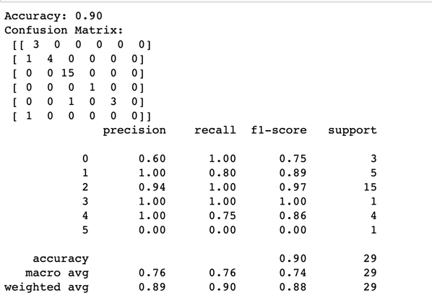
TESTING / PERFORMANCE ANALYSIS
SYSTEM TESTING
The testing and the evaluation part are the most important part in any research or development of a model. As we need to understand and check whether our model is performing the way it should be.
Decision Tree
The accuracy and the classification
report is as follows.

Slide 18
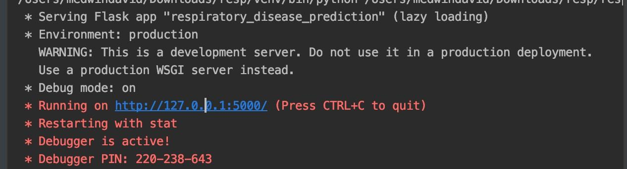
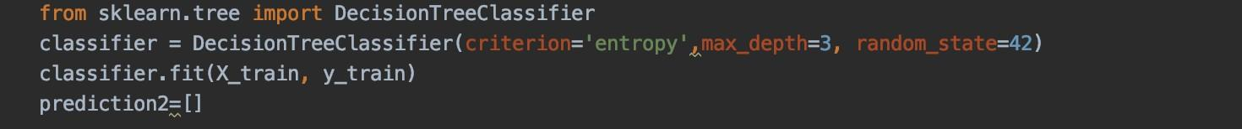
Web Application Testing
We use the flask framework for developing the webapp, along with CSS and html. On starting the application, it is bonded to a default address http://127.0.0.1:5000/
On entering the diseases prediction page, the best performing algorithm, Decision tree is called to do the classification for the input data. The input is then validated with an algorithm and the training data from our model and predicts the result for the input given by the user.

Slide 19
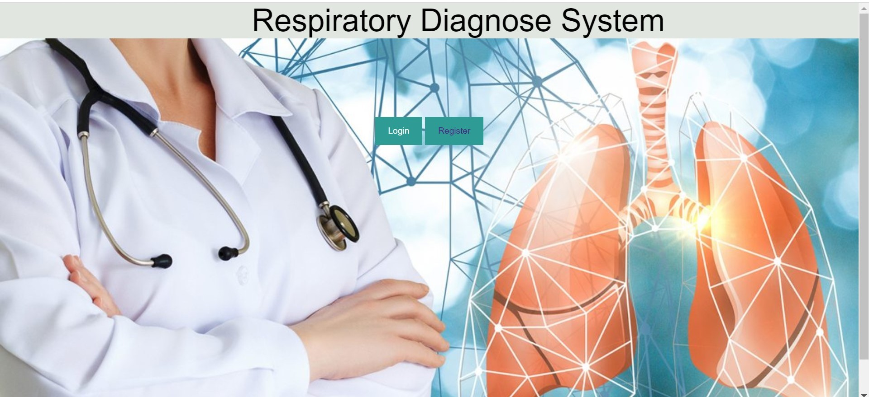
SCREENSHOTS
HOME PAGE

Slide 20

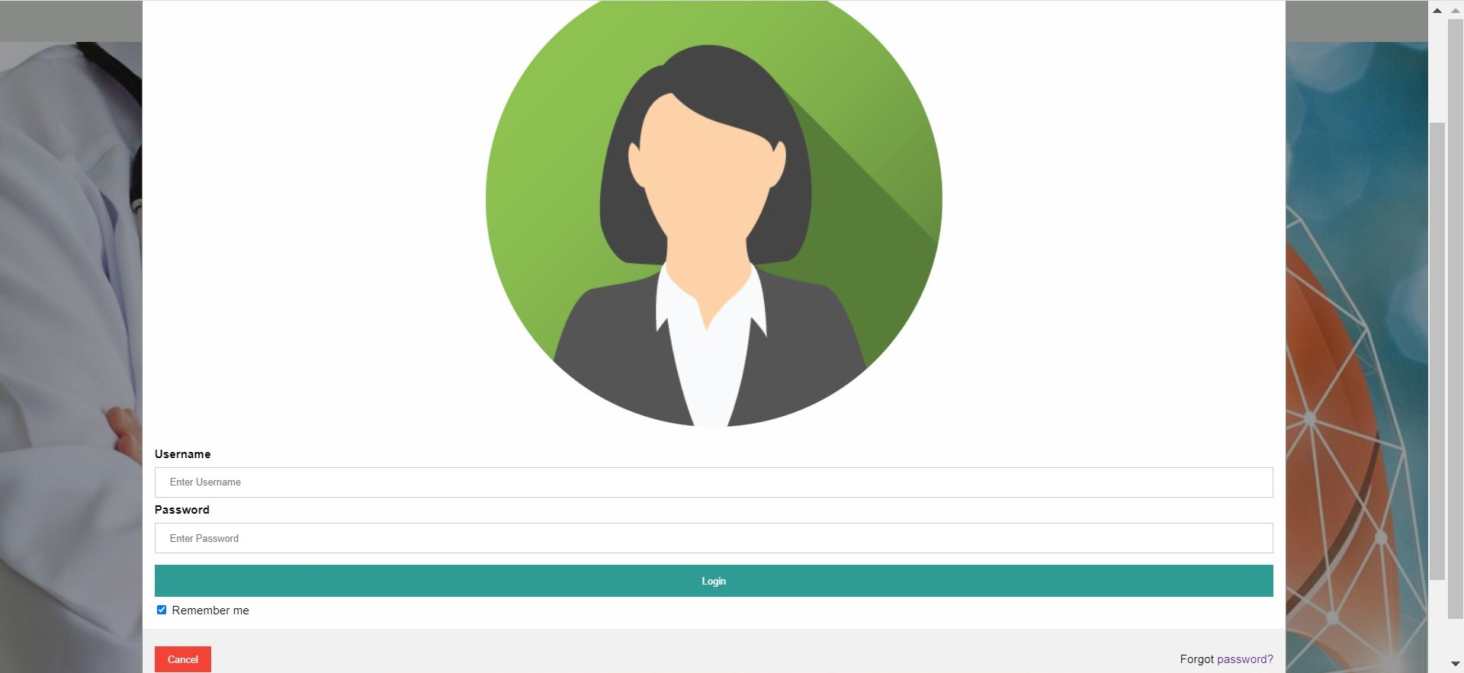
REGISTER PAGE
LOGIN PAGE

Slide 21
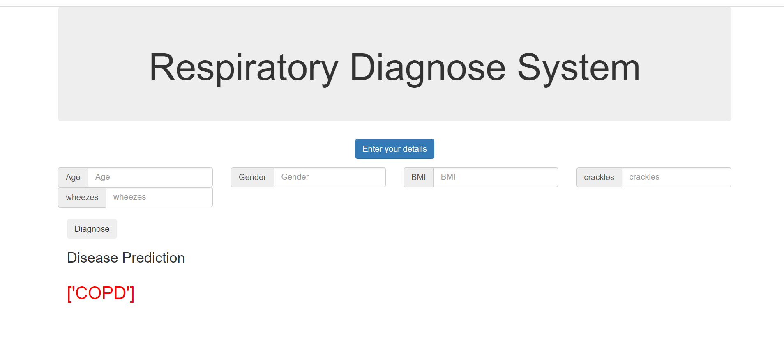
DISEASE PREDICTION USING WHEEZES AND CRACKLES

Slide 22
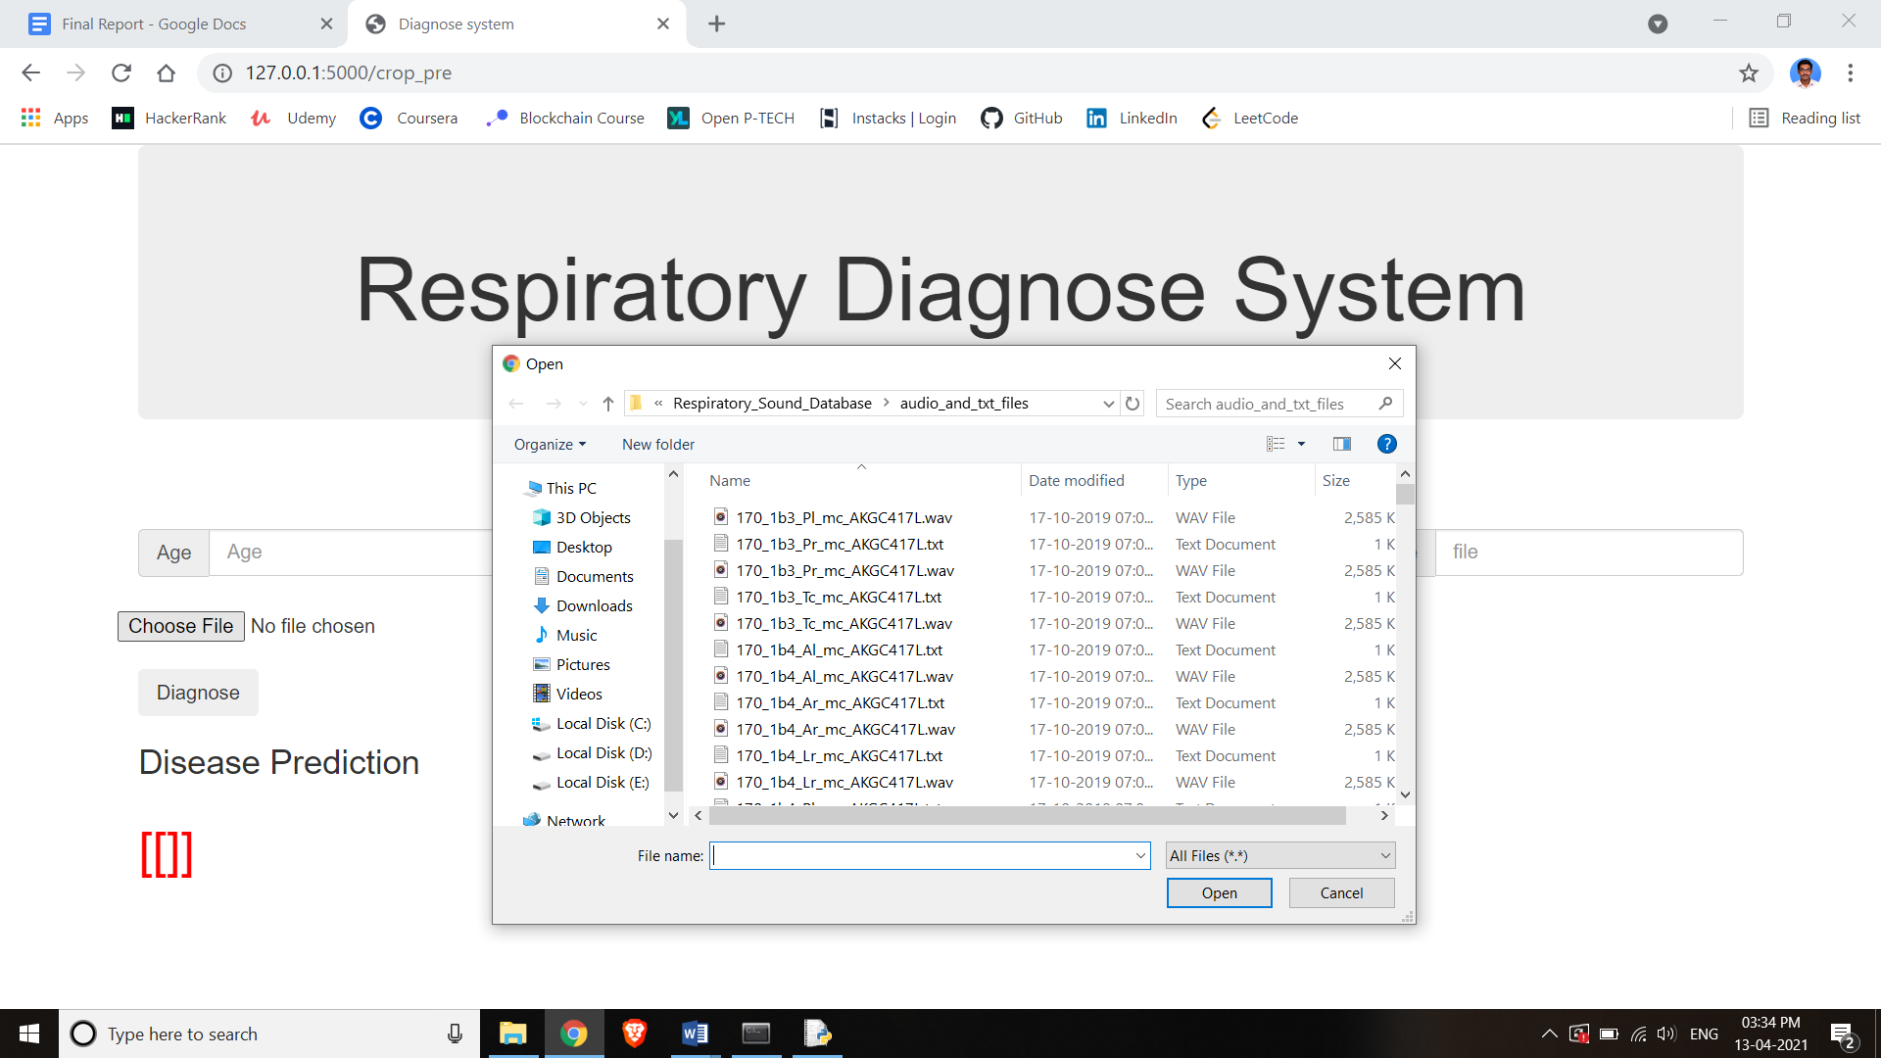
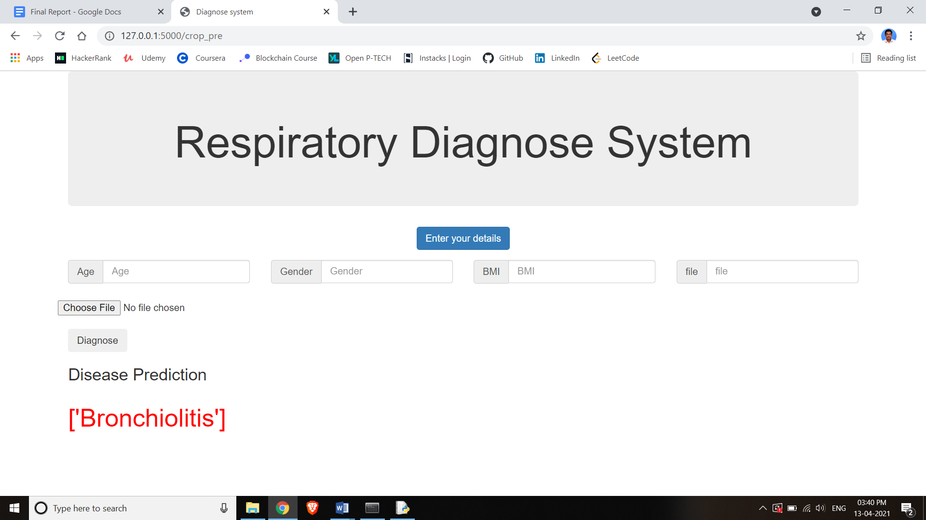
UPLOADING AUDIO FILE FOR PREDICTION
DISEASE PREDICTION USING AUDIO FILE

Slide 23
CONCLUSION
In our project, we have predicted respiratory diseases from the respiratory sounds database using decision trees. Our work comprised of the comparison with machine learning algorithm. Our project mainly consists of three areas, pre-processing of the data, prediction of diseases, and developing the interface for users to use. In the pre-processing, we are handling the missing data, normalizing the values and eliminating any unwanted data from our dataset and creating a new preprocessed data. The prediction with decision trees gives an accuracy rate of 90 percent. CNN models can be used when there is a large amount of data is available to train, when learning with less data the CNN model is not as appropriate as over fitting occurs in the training of model.

Slide 24
REFERENCES
1. Welsby, P.D., Parry, G. and Smith, D. ‘The Stethoscope: Some Preliminary Investigations’. Postgraduate Medical Journal (2003)
2. Swarup, S. and Makaryus, A.N. ‘Digital Stethoscope: Technology Update’.Medical Devices (2018)
3. Sandra Reichert, Gass Raymond, Christian Brandt, Emmanuel Andres ‘Analysis of Respiratory Sounds: State of the Art’. Clinical Medicine. Circulatory, Respiratory and Pulmonary Medicine, (2008)
4. H Kiyokawa, M Greenberg, K Shirota, H Pasterkamp ‘Auditory detection of simulated crackles in breath sounds’ Chest. 2001 Jun;119(6):1886-92.doi: 10.1378/chest.119.6.1886.(2001)
5. Zimmerman, B. and Williams, D. ‘Lung Sounds’. In StatPearls. Treasure Island (FL): StatPearls Publishing. Available at: http://www.ncbi.nlm.nih.gov/books/NBK537253/ . (2020a)
6. Zimmerman, B. and Williams, D ‘Lung Sounds’. In StatPearls. Treasure Island (FL): StatPearls Publishing. Available at: http://www.ncbi.nlm.nih.gov/books/NBK537253/ (2020b)
7. Emmanuel Andres, Amir Hajjam. ‘Advances and Perspectives in the Field of Auscultation, with a Special Focus on the Contribution of New Intelligent Communicating Stethoscope Systems in Clinical Practice, in Teaching and Telemedicine’.EHealth and Remote Monitoring. InTech. (2012)
8. B. M. Rocha, D. Filos, L. Mendes, I. Vogiatzis, E. Perantoni, E. Kaimakamis, P. Natsiavas, A. Oliveira, C. Jácome, A. Marques, R. P. Paiva, I. Chouvarda, P. Carvalho, N. MaglaverasΑ. ‘Respiratory Sound Database for the Development of Automated Classification’ Precision Medicine Powered by PHealth and Connected Health. IFMBE Proceedings. Singapore: Springer Singapore(2018)

Slide 25
9. Renars Xaviero Adhi Pramono, Stuart bowyer, Esther Rodriguez-Villegas ‘Automatic Adventitious Respiratory Sound Analysis: A Systematic Review’ (2017)
10. Singh, A., Thakur, N. and Sharma, A. ‘A Review of Supervised Machine Learning Algorithms’3rd International Conference on Computing for Sustainable Global Development (INDIACom) (2016)
11. Georgios Ntritsos, Jacob Franek, Lazaros Belbasis, Maria A Christou, Georgios Markozannes, Pablo Altman, Robert Fogel, Tobias Sayre,Evangelia E Ntzani, Evangelos Evangelou. ‘Gender-specific estimates of COPD prevalence: a systematic review and meta-analysis’ International Journal of Chronic Obstructive Pulmonary Disease (2018).
IMAGE REFERENCES
1. https://www.pngitem.com/middle/ooRiRm_users-man-woman-man-woman-transparent-hd-png/
2. https://www.pngkey.com/detail/u2w7w7u2t4a9y3r5_register-user-register-online-icon-png/
3. https://www.pngitem.com/middle/ixmxTbR_user-login-icon-png-transparent-background-login-icon/
4. https://www.iconfinder.com/icons/649116/account_details_document_profile_send_upload_user_icon
5. https://www.pngitem.com/middle/JxwRwJ_machine-learning-model-png-transparent-png/
6. https://dryicons.com/icon/gear-icon-13082
7. https://thenounproject.com/term/evaluation/1132369/
8. https://www.123rf.com/photo_141068088_stock-vector-human-lung-disease-prediction-icon-as-eps-10-file.html
9. https://www.iconfinder.com/icons/6802116/computer_accessory_display_screen_monitor_output_device_screen_icon

